Slide 1

Monitus
Prediction tool based on financial statements
Capstone Project by Tommy Cheung
(Mar 2021 DS Stream)

Slide 2
Content
Project background
Business value
Data processing
Model development
App publishment
Future plan

Slide 3
Project background
Little ML study on financial statement (F/S)
Applying prior knowledge as an accountant
Extension from prior NLP project
Use as career portfolio

Slide 4
Business value
Investors:
One-click obtain latest F/S
Predict ratios and growths for investment purpose
Media:
Search for company info
Investigate potential bankrupt companies
Others:
Explore ML models used for prediction

Slide 5
Project name
monitus
(feminine monita, neuter monitum)
1. advised, warned, having been advised.
2. reminded, having been reminded.
(https://en.wiktionary.org/wiki/monitus)

Slide 6
Main goal
Provide company info
Provide financial statement
Bankruptcy prediction
Sentiment analysis
Investment appraisal

Slide 7
Obtaining data
US Government (SEC)
Free Stock API and Financial Statements API - FMP API (financialmodelingprep.com)
Kaggle - Bankruptcy data from TW companies

Slide 8

Data-preprocessing
Most time spent here
Financial statement: numbers with various ranges
Text from documents
Perform EDA on numerical values first

Slide 9
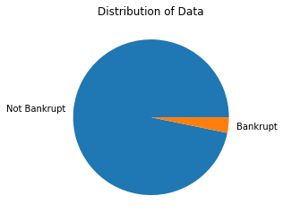
Bankruptcy dataset
From: Taiwan bankruptcy dataset (Kaggle)
Bankrupt (0/1) vs financial ratios
Remove redundant columns
Dropping mostly nulls columns
Apply StandardScaler
Highly biased: applied SMOTE

Slide 10
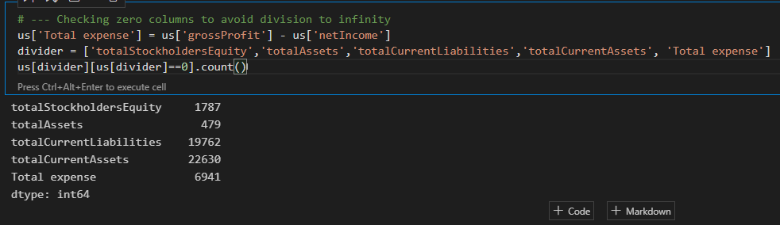
Selecting proper columns
Little correlation
Useful information
Can be matched with the US dataset
Be careful of null columns

Slide 11
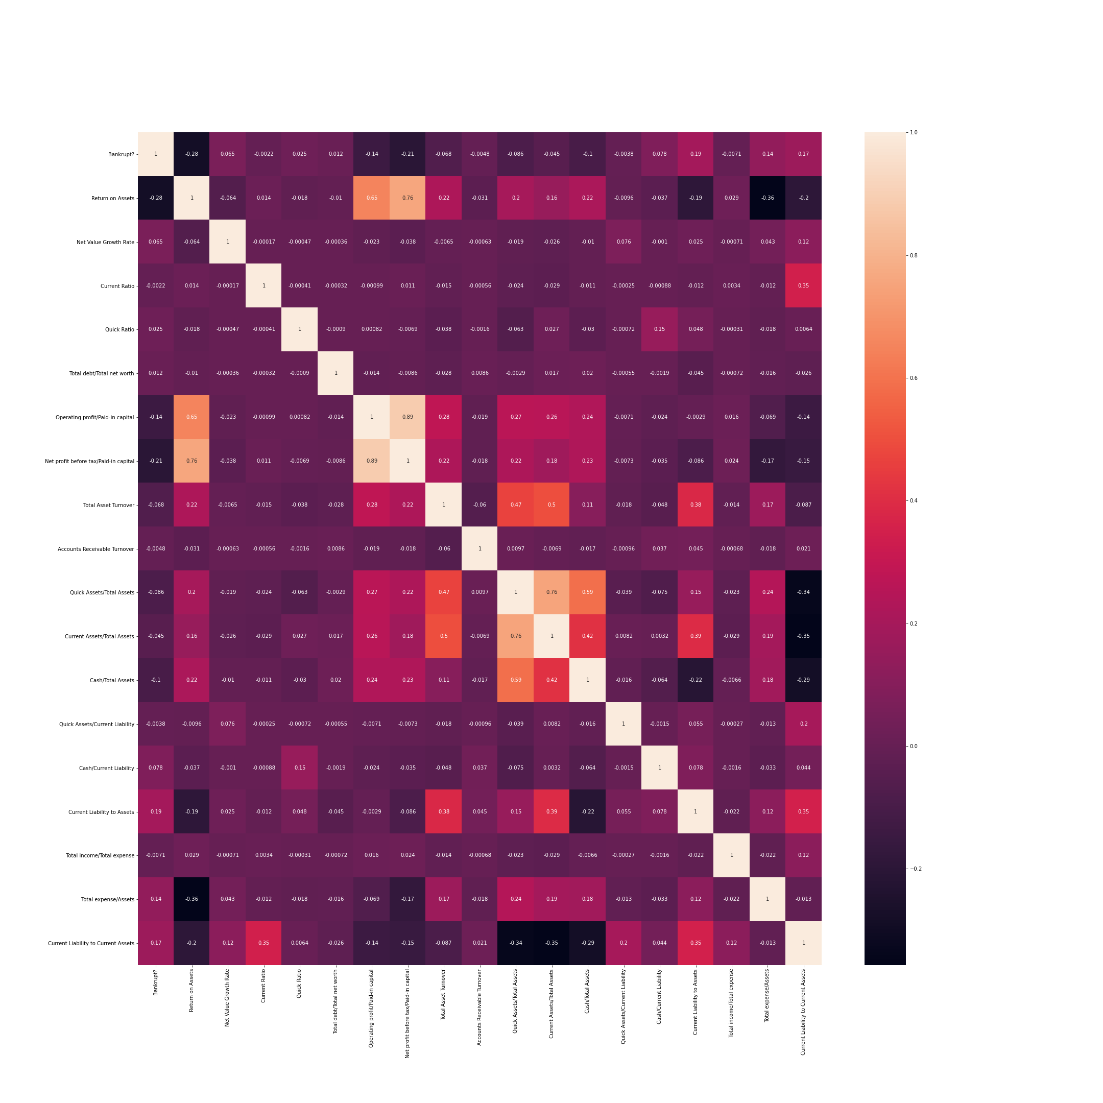
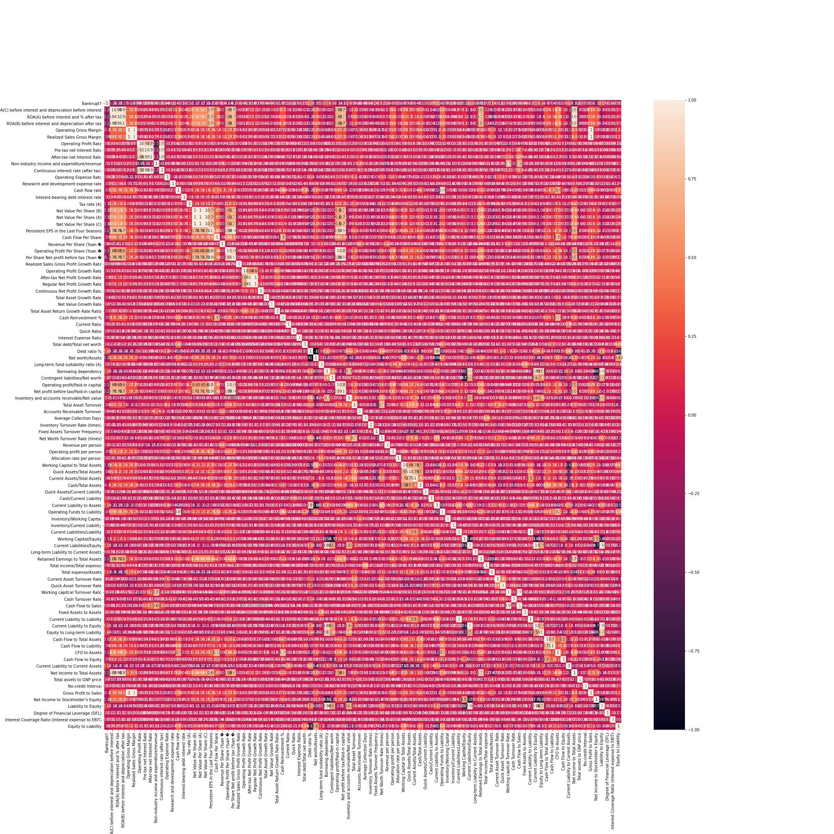

Slide 12
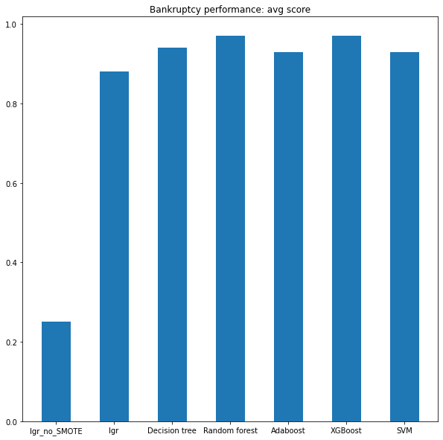
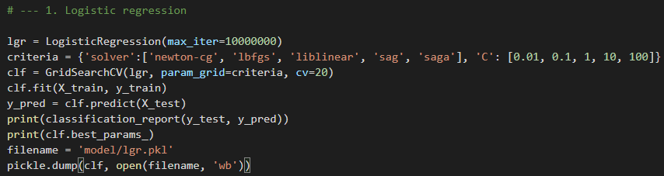
Model
Classification models:
Logistic regression
Decision tree
Random forest
Adaboost
XGBoost
SVM
GridSearchCV for hyperparameter tuning
Result: chose Random Forest

Slide 13
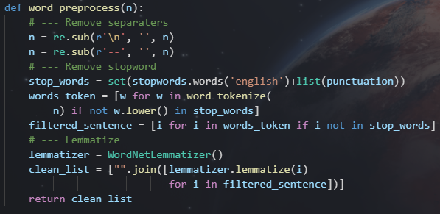
Earnings Call dataset
Word pre-processing
Sentiment analysis
TextBlob
Sentiment Intensity Analyzer
Prediction
Vs DividendGrowth in US dataset
CountVectorizer
Tfidfvectorizer

Slide 14
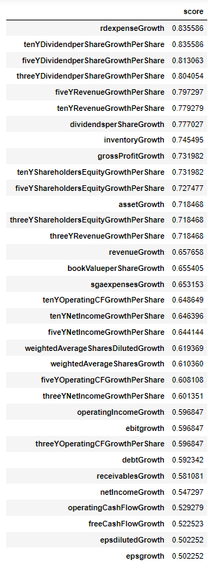
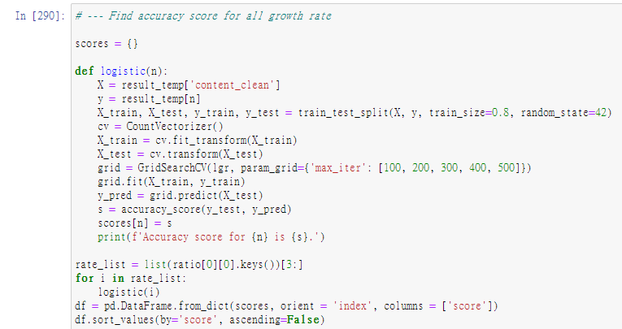
Performance

Slide 15
Investment appraisal
Explorative work
Use ratios/cashflow figures to predict growth
Only deploy on app when having high accuracy

Slide 16
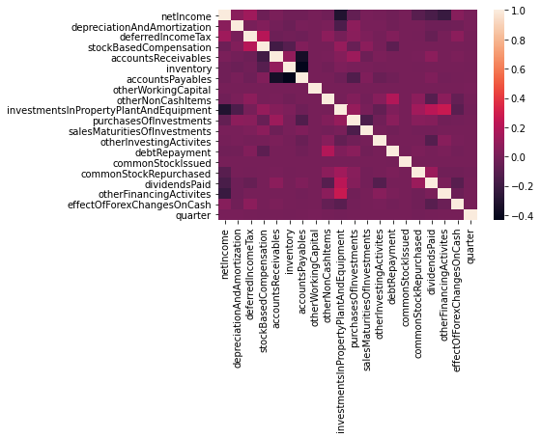
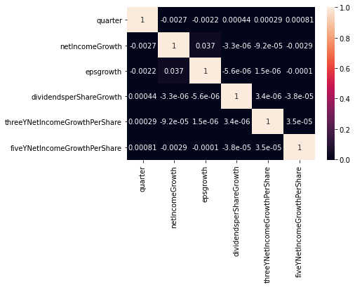
Column selection
Cashflow (after filtering)
Growth to be predicted

Slide 17
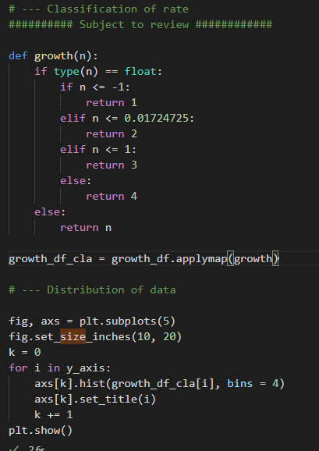
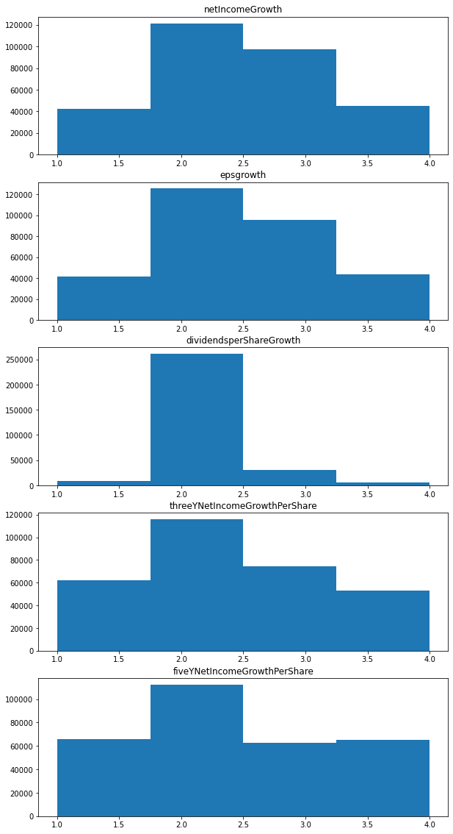

Slide 18
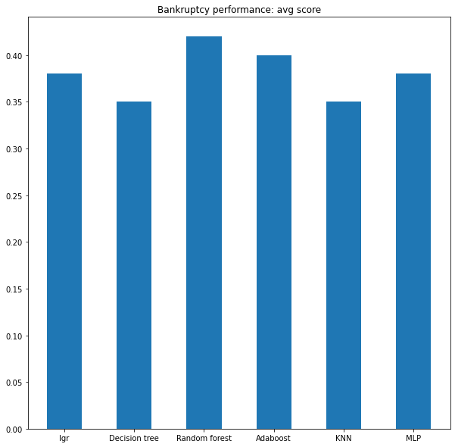
Performance
Classification models:
Logistic regression
Decision tree
Random forest
Adaboost
KNN
GridSearchCV for hyperparameter tuning
Neural network using MLPClassifier
Overall: unsatisfactory, to be further studied

Slide 19
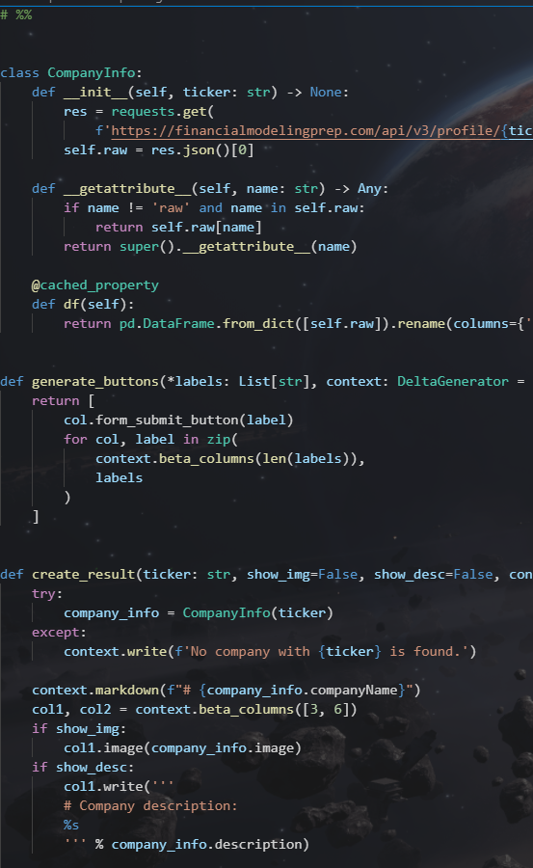
Streamlit App demonstration

Slide 20
In the future…
Improve model of ratio-to-growth prediction
Add stock price prediction using time-series model
Adding documentation on models for education
Hosting app on server with SQL

Slide 21
Reference
Amel-Zadeh, Amir and Calliess, Jan-Peter and Kaiser, Daniel and Roberts, Stephen, Machine Learning-Based Financial Statement Analysis (November 25, 2020). Available at SSRN: https://ssrn.com/abstract=3520684 or http://dx.doi.org/10.2139/ssrn.3520684
Perols, Johan. (2010). Financial Statement Fraud Detection: An Analysis of Statistical and Machine Learning Algorithms. Auditing A Journal of Practice & Theory. 30. 10.2308/ajpt-50009. SSRN: https://www.researchgate.net/publication/256045322
Free Stock API and Financial Statements API - FMP API (financialmodelingprep.com)
https://www.kaggle.com/fedesoriano/company-bankruptcy-prediction

Slide 22

As a final note…

Slide 23
Thank you!

